Slide 1
Digestive System as a Whole

Slide 2
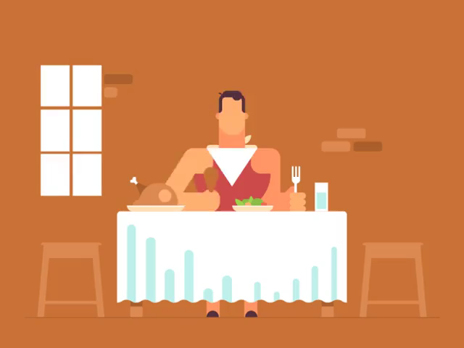
Welcome to the digestive system module!
Have you ever wondered about the journey your food makes through your body? Where does it go? How is it broken down?
All these questions, plus many more, will be answered throughout the course of this module. Sit back and prepare for some foody fun!

Slide 3
By the end of this Lesson you should be able to:
1. | Recall and identify the organs that make up the digestive system.
2. | Explain the functions of the main organs of the digestive system.
3. | Explain what mechanical and chemical digestion are.

Slide 4


Slide 5
The Digestive System
The digestive system is made up of the gastrointestinal (GI) tract (also called the digestive tract), the liver, pancreas and gallbladder.

Slide 6
The GI tract is a series of hollow organs joined in a long, twisting tube from the mouth to the anus.
The hollow organs that make up the GI tract are the mouth, oesophagus, stomach, small intestine, large intestine (which includes the rectum) and anus.

Slide 7
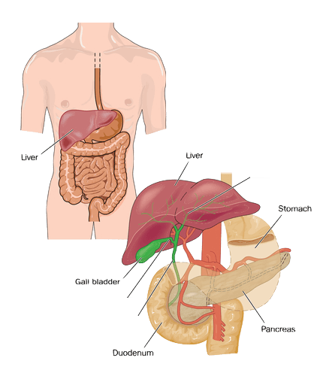
The liver, pancreas, and gallbladder are the solid organs of the digestive system, which surround the hollow tube of the GI tract.

Slide 8
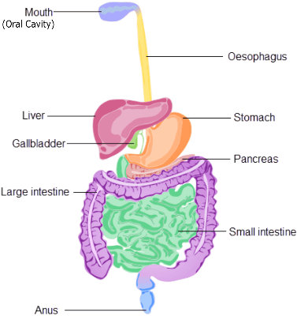
Below is a diagram indicating where each organ of the digestive system is located.

Slide 10
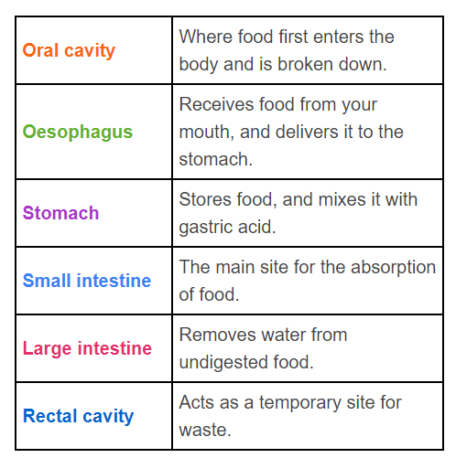
Here is a summary of the function of the digestive organs:

Slide 11
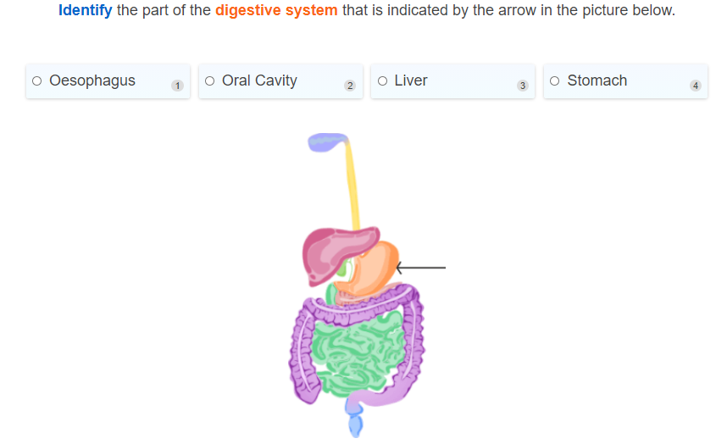

Slide 12
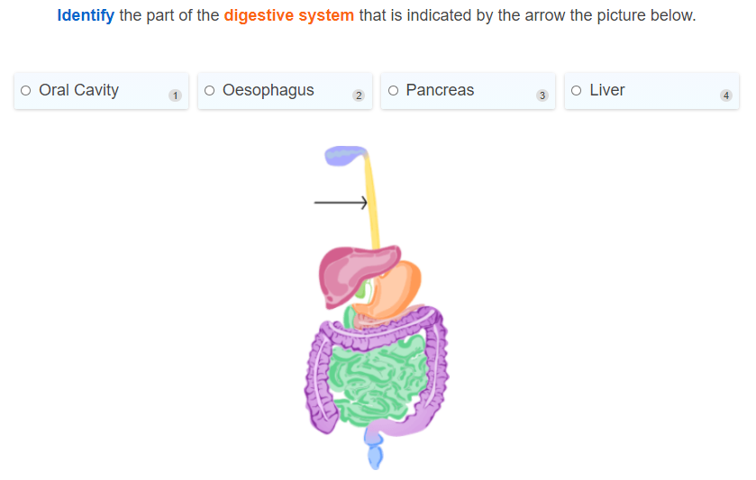

Slide 13
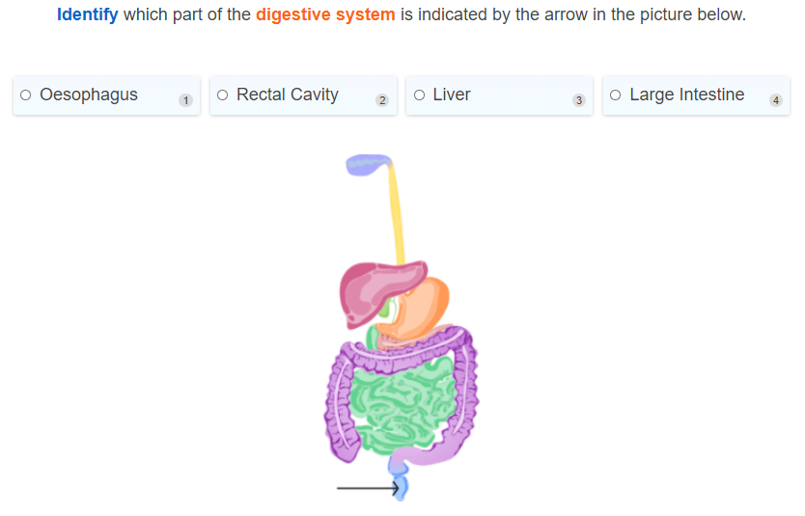

Slide 14
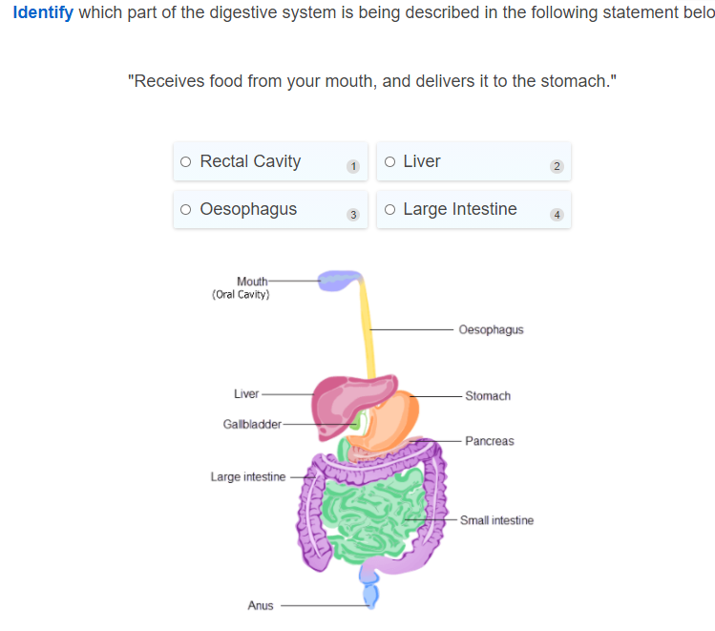

Slide 15
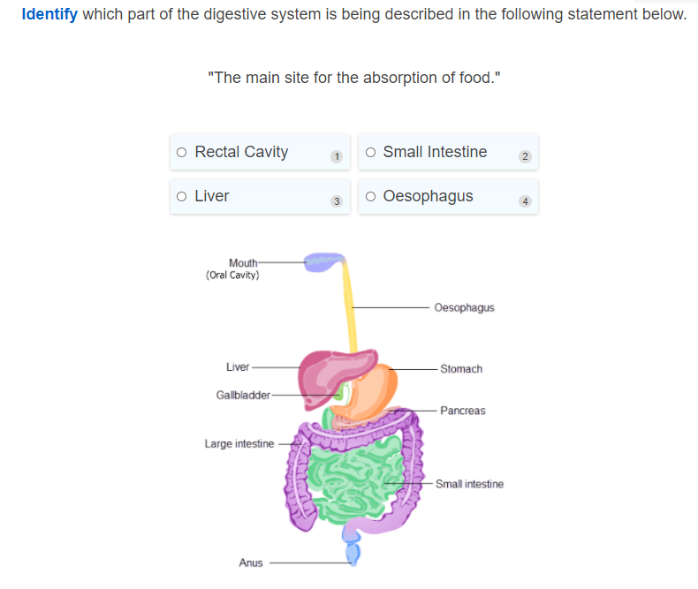

Slide 16
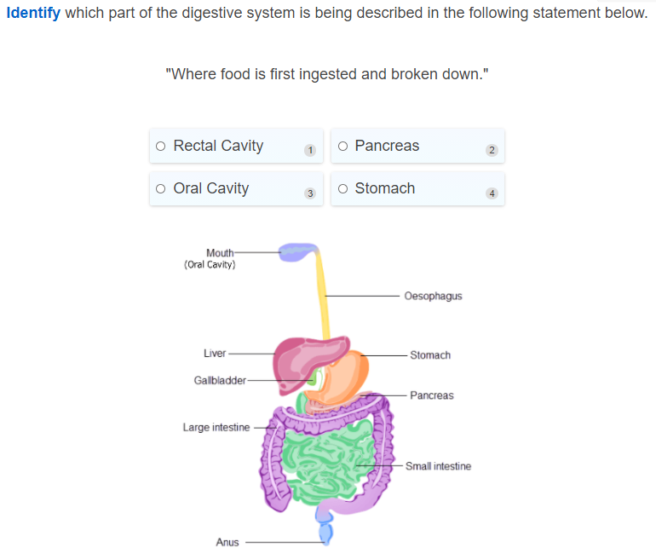

Slide 17
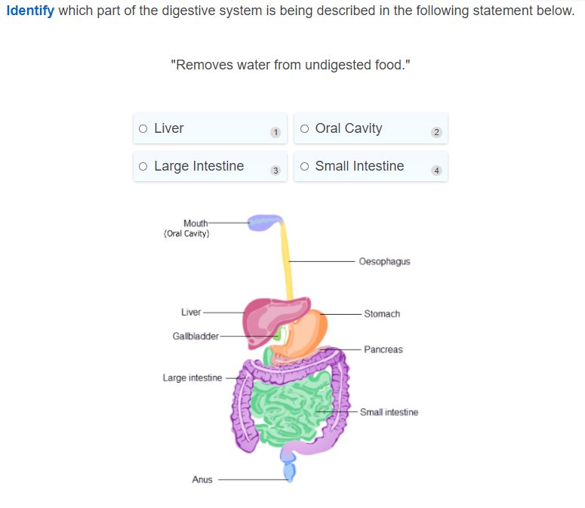

Slide 18
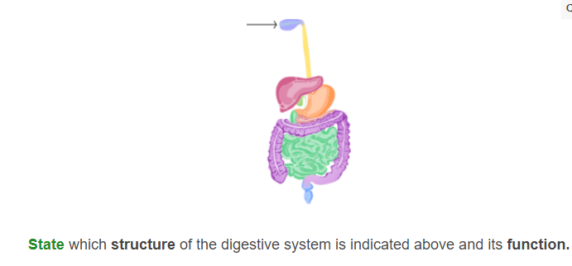

Slide 19
There are two types of digestion: mechanical and chemical digestion.

Slide 21
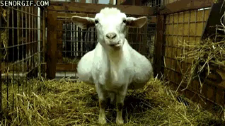
Mechanical digestion is when food is physically broken up into smaller pieces.
For example, large pieces of bread become smaller pieces of bread when you chew them.

Slide 22
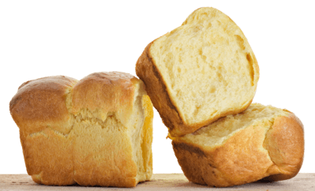
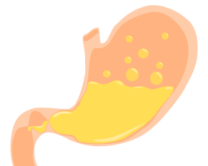
Chemical digestion is when the complex molecules in food are broken into simpler molecules.
This is done by using enzymes (a special kind of chemical). It's a common misconception that stomach acid digests food. Actually, the acid activates an enzyme called pepsin that will digest parts of the food.
For example, the starch (a type of carbohydrate) in bread is broken up into sugar (glucose) by enzymes in the saliva and stomach.

Slide 23
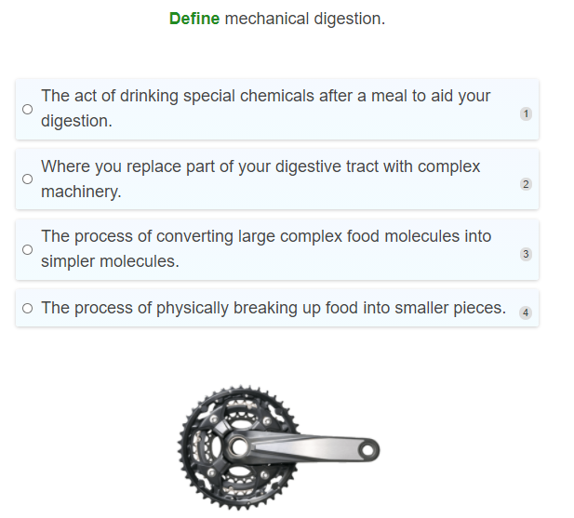

Slide 24
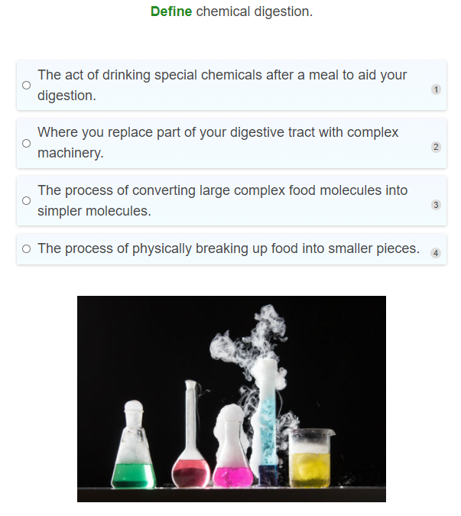

Slide 25
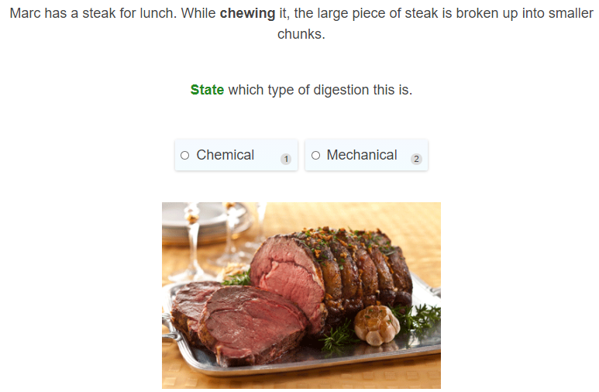

Slide 26
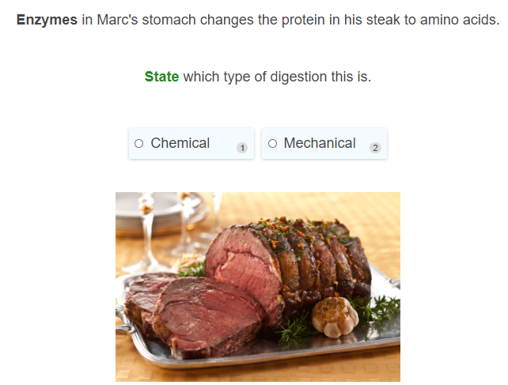

Slide 27
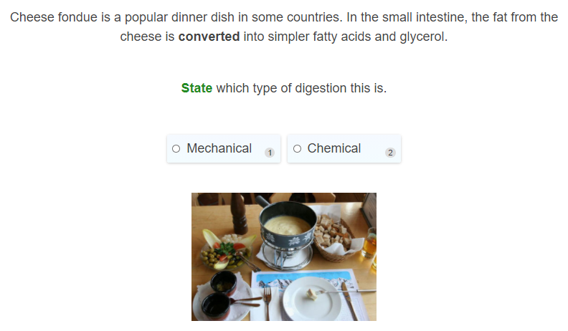

Slide 28
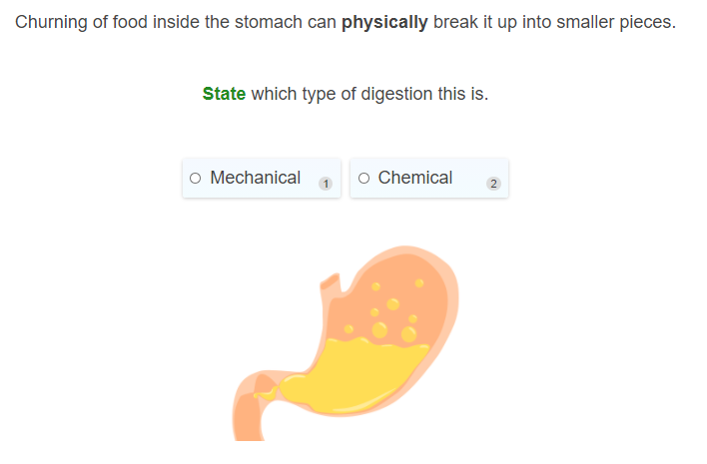

Slide 29
